Slide 1


Introduction TEAM HEXA

Slide 2






WIN WIN KHING
PHYU PHYU THIN
AHKAR TOE MAW
MYO MIN HTOO
SAN LIN PHYO
KHAM NYEIN CHAN AUNG

Slide 3
What is News Website ?
A news website is the online version of a newspaper, either as a stand-alone publication or as the online version of a printed periodical. Going online created more opportunities for newspapers, such as competing with broadcast journalism in presenting breaking news in a more timely manner.

Slide 4




Roles and Features of Hexa News
Admin
Admins have full control of everything and everyone
Login User
Random User
Website Visitors can only read and search news
Users can read news, search news, comment on news, delete and edit their own comments
Reporter
Reporter can post news and they have control of their posts and comments on their posts

Slide 5
Support 133 languages

Slide 6
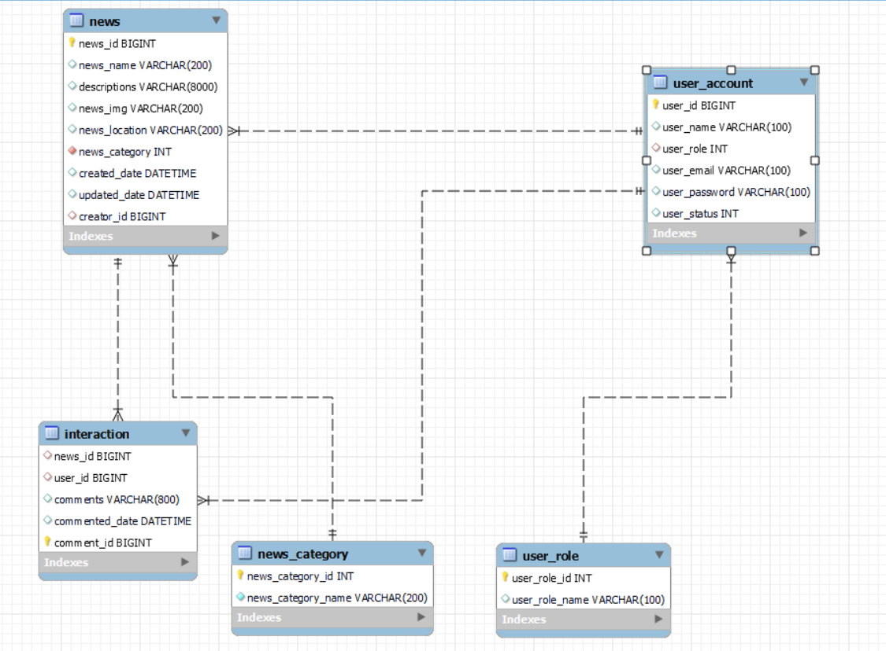
E
R
D

Slide 7







Techonologies
1. JSP
2. Bootstrap
3. Jquery
4. Ajax
5. Java 11
6. Spring Boot
7. MySQL
8. Eclipse
9. Git & GitHub

Slide 8

Future Plans
Morbi euismod lectus mauris, id ornare tortor convallis in. Sed consectetur ipsum erat, et tristique arcu varius eu. Praesent fermentum elit ut nisi venenatis, et luctus justo auctor. Sed justo nibh, venenatis quis eleifend id, cursus at est. Phasellus faucibus.

Slide 9
Thank You !

